Slide 1



AGENDA: DEVSECOPS
What is DevSecOps ?
DevSecOps Ecosystem / Flowchart / Components
DevSecOps Level’s / Tool’s
DevSecOps - SAST & DAST

Slide 2
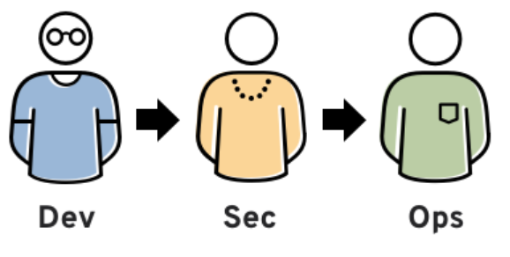
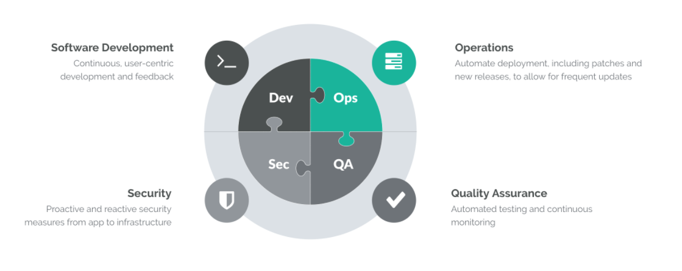
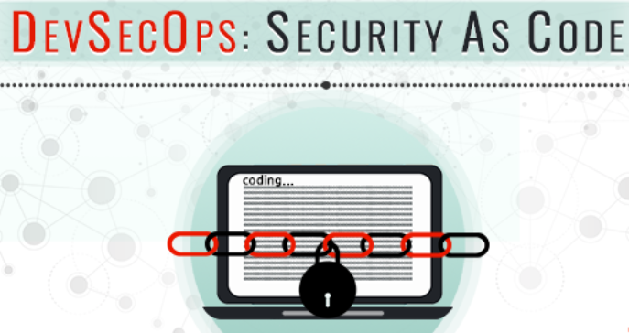
DEVSECOPS
What is DevSecOps ?
DevOps isn’t just about development and operations teams. If you want to take full advantage of the agility and responsiveness of a DevOps approach, IT Security must also play an integrated role in the full life cycle of your apps
Why? In the past, the role of security was isolated to a specific team in the final stage of development. That wasn’t as problematic when development cycles lasted months or even years, but those days are over. Effective DevOps ensures rapid and frequent development cycles (sometimes weeks or days), but outdated security practices can undo even the most efficient DevOps initiatives.

Slide 3
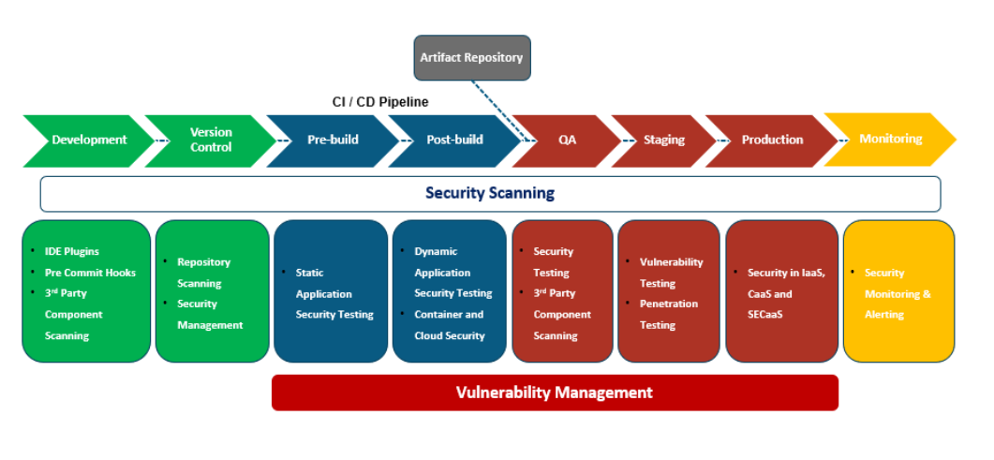
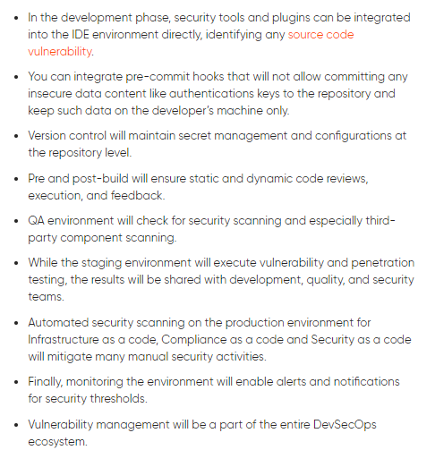
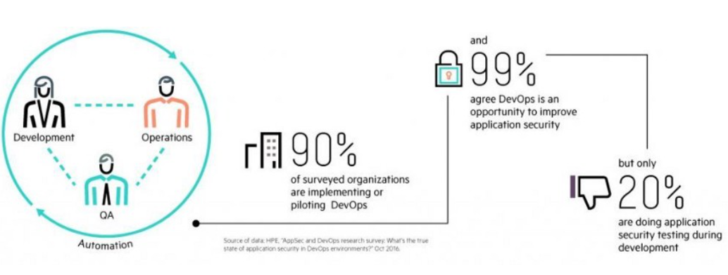
DevSecOps | Ecosystem
Flow of different phases in the DevSecOps ecosystem. Here security scanning will be a part of the complete ecosystem

Slide 4
DevSecOps Release Management Process - Flowchart
Backlog
Bugs
Diagnostics
App Monitoring
Infra Monitoring
Usage Analytics
Feedback
Unit tests
Code Coverage
Code Analytics
Code Metrics
Code Vulnerabilities
Code Profiling
Environment Tests
Automated Tests
Load Tests
Pen Tests
Exploratory Tests
Test Data
A/B Testing
Blue-Green/
Canary
Rollback
Author
Code
Check-In
Build
Version Control
DEV
QA/Test
UAT
Staging
Prod
Author
Infra
Version Control
Artifact Repo
Provision Infra
Deploy App
Deploy Tests
Author
Tests
Software Delivery Pipeline
Business Innovation
Business
Agility

Slide 5
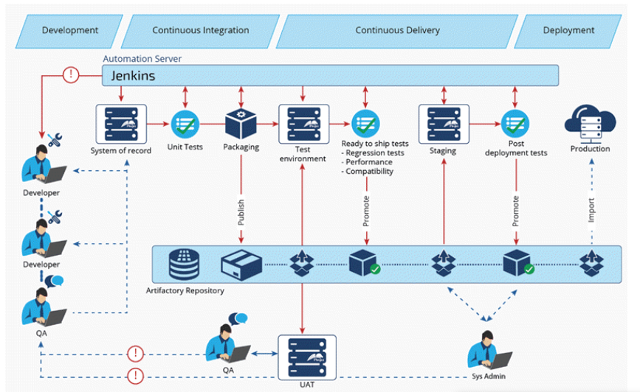

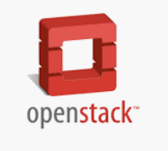


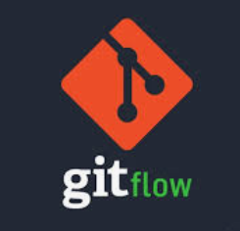
DevOps Software Release Flowchart

Slide 6
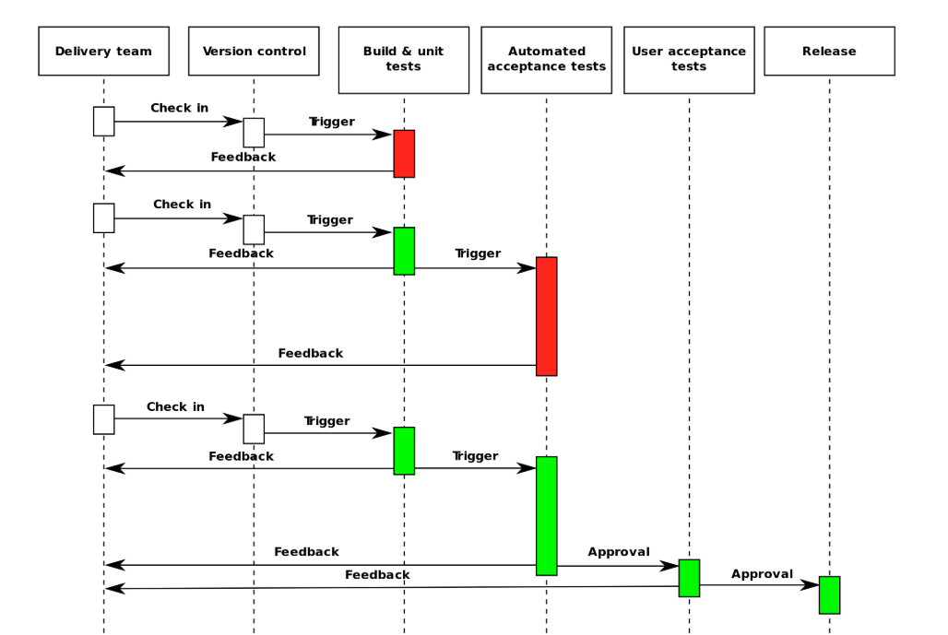
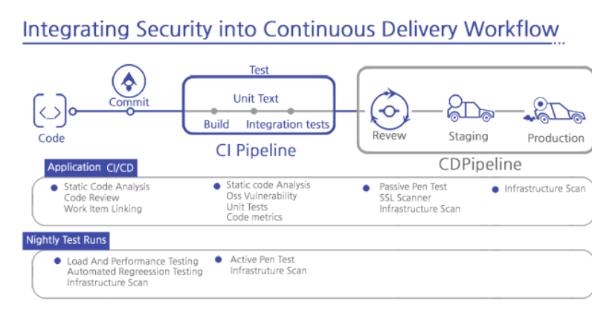
Software Lifecycle - Approvals & Rollbacks
FLOWCHART | DevSecOps
Accelerate Delivery
Balance Speed, Cost, Quality, and Risk.
Reduce Time to Feedback.

Slide 7
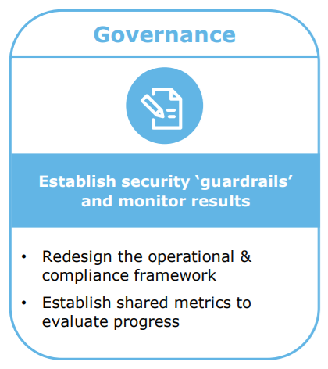
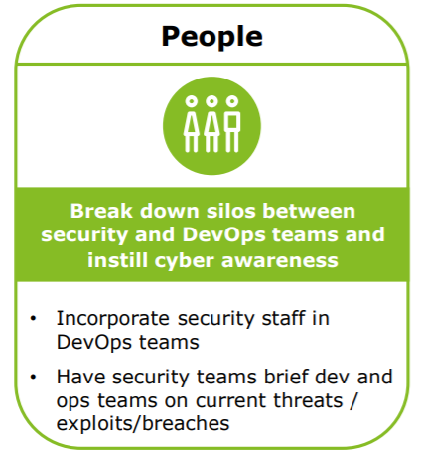
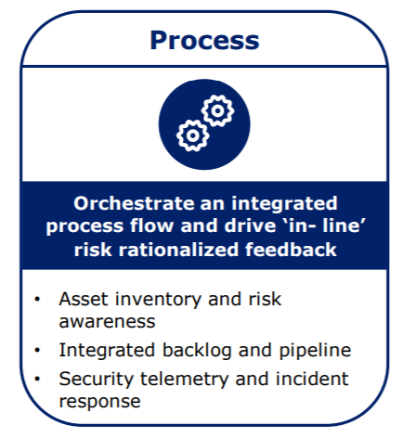
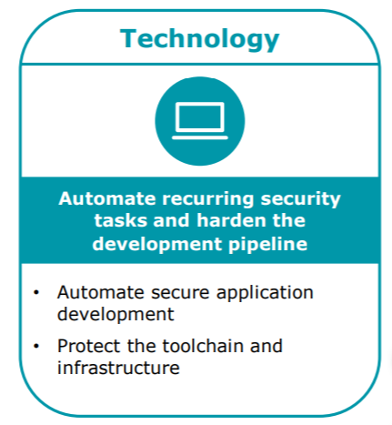
DevSecOps | Components
Team Composition
DevSecOps is the philosophy of integrating security practices within the DevOps process & involves creating a ‘Security as Code’ culture.
Components
Code analysis – deliver code in small chunks so vulnerabilities can be identified quickly.
Change management – increase speed and efficiency by allowing anyone to submit changes, then determine whether the change is good or bad.
Compliance monitoring – be ready for an audit at any time (which means being in a constant state of compliance, including gathering evidence of GDPR & PCI Compliance, etc.).
Threat investigation – identify potential emerging threats with each code update and be able to respond quickly.
Vulnerability assessment – identify new vulnerabilities with code analysis, then analyze how quickly they are being responded to and patched.
Security training – train software and IT engineers with guidelines for set routines.

Slide 8
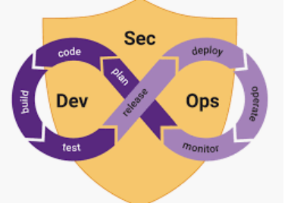
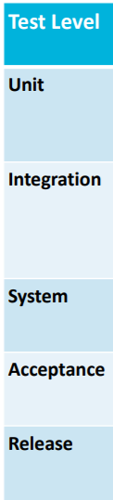
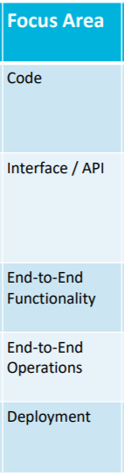
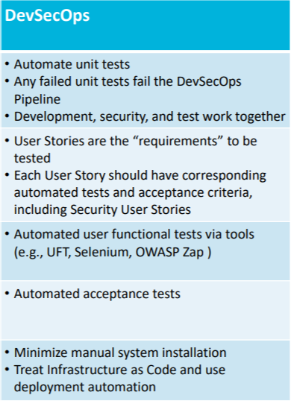

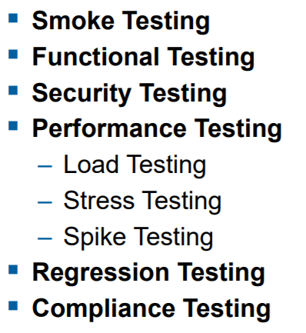

DevSecOps – Test Level’s
A transformational shift which incorporates secure culture, practices, and tools to drive visibility, collaboration, and agility of security into each phase of the DevOps pipeline.

Slide 9

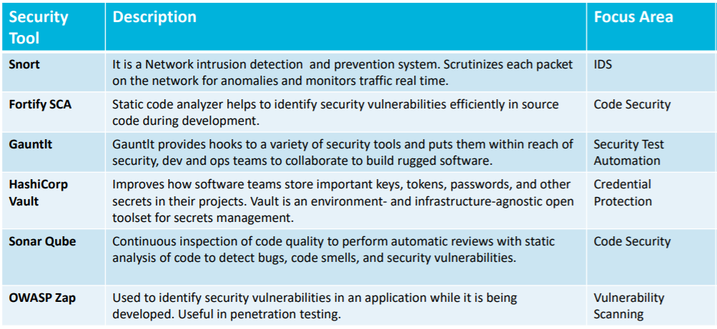
DevSecOps – Security Tool’s

Slide 10

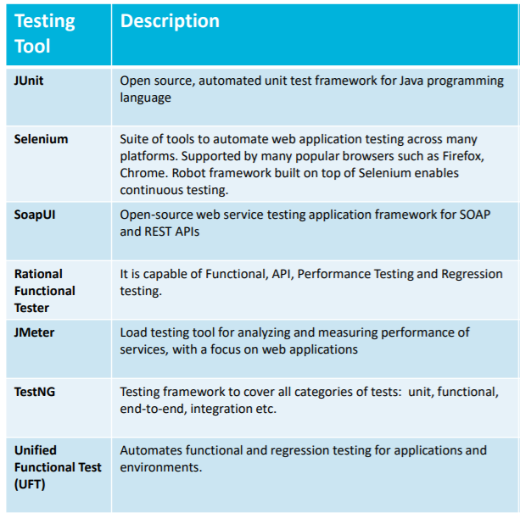
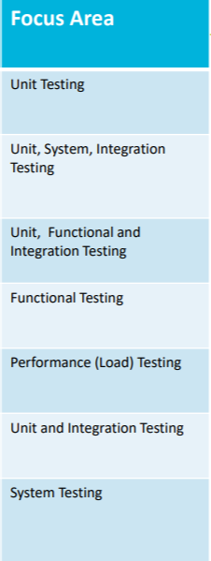
DevSecOps - Testing

Slide 11

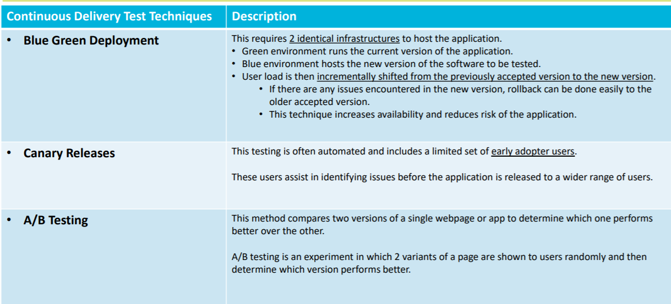
DevSecOps - Delivery

Slide 12
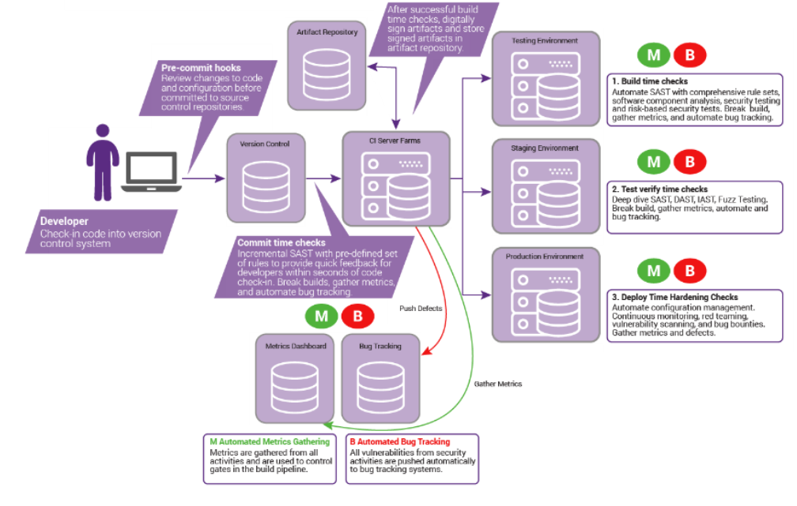
DevSecOps – SAST / DAST
(Static Application Security Testing / Dynamic Application Security Testing)

Slide 13
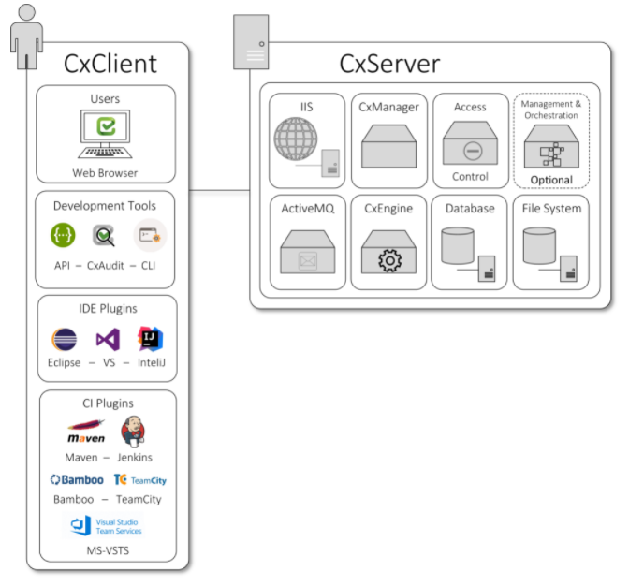
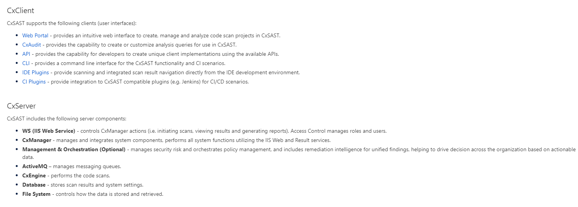
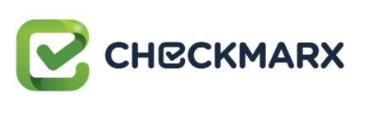
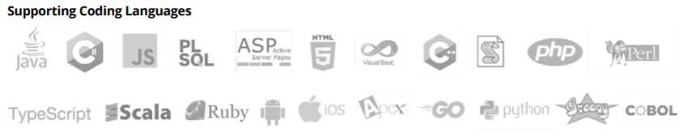
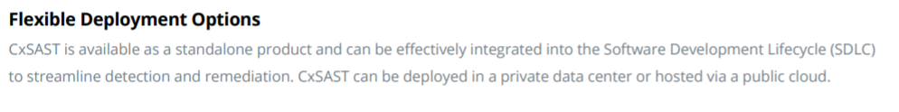
DevSecOps – CheckMarx ( SAST / DAST )
Checkmarx CxSAST / CxDAST (Static Application Security Testing / Dynamic Application Security Testing) is a unique source code analysis solution & widely used tool, that provides tools for identifying, tracking, and repairing technical and logical flaws in the source code, such as security vulnerabilities, compliance issues, and business logic problems
You can integrate CheckMarx into several aspects of your development cycle, such as with software build automation tools (Apache Ant and Maven), software development version control systems (GIT), issue tracking and project management software (JIRA), continuous integration platforms, continuous code quality inspection platforms (SonarQube) & many more.

Slide 14
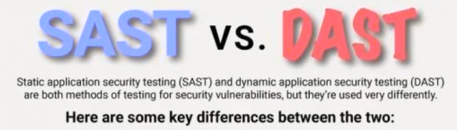
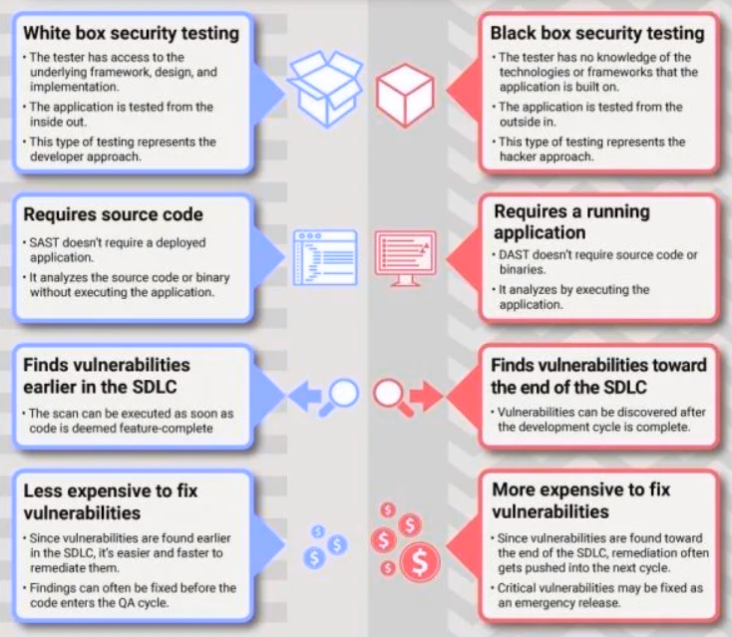
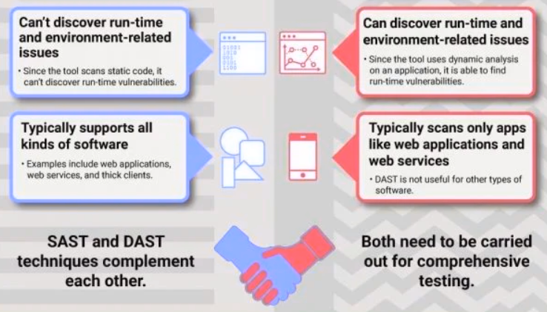
DevSecOps – SAST v/s DAST

Slide 15
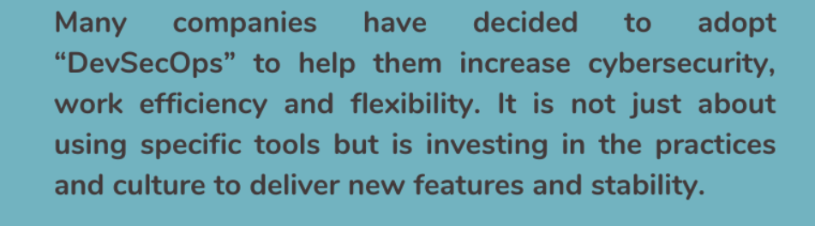
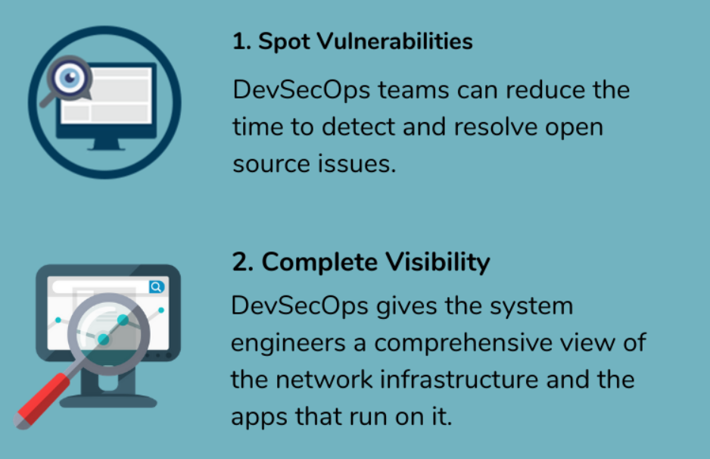
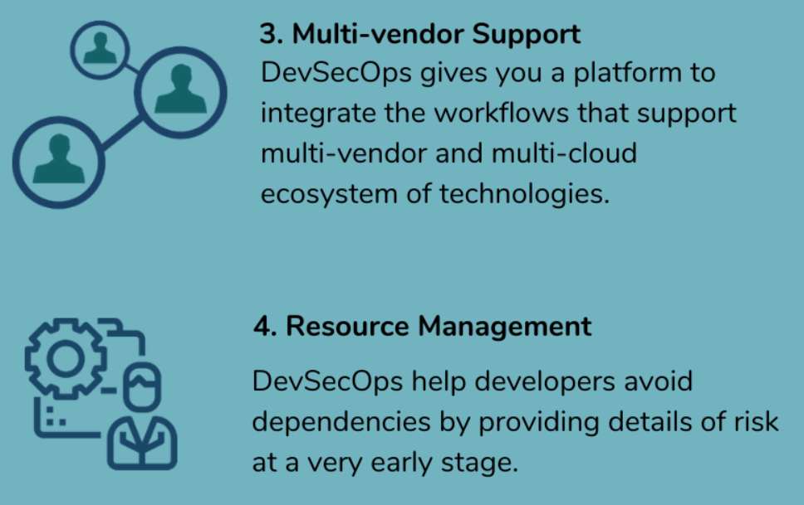
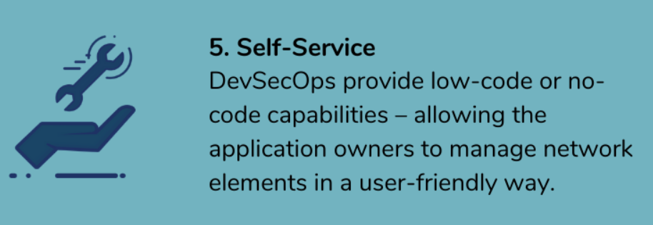
DevSecOps – Benefit’s

